Slide 1
Parallelism in Sentences
Talha Memon

Slide 2
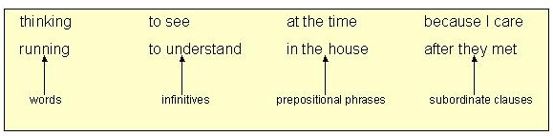
Parallelism in Sentences using Conjunctions
Here are some examples of parallel elements

Slide 3
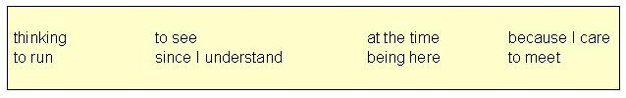
Parallelism
These elements, on the other hand, are not parallel

Slide 4
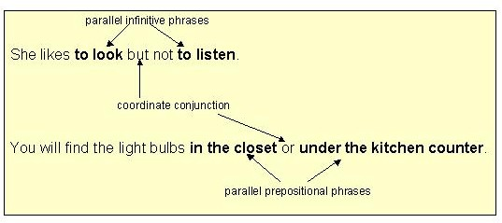
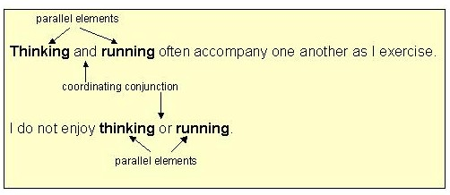
Five Ways to develop parallelism in writing
With elements joined by coordinating conjunctions, especially and, but, and or.
Examples of parallel phrases

Slide 5
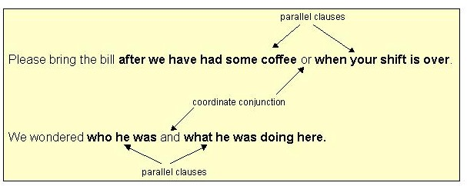
Parallelism…cont’d
Examples of parallel clauses

Slide 6
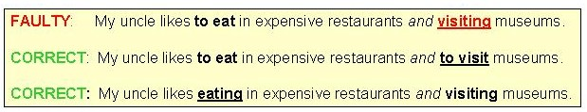
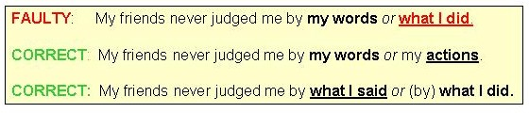
Faulty parallelism
The examples below show how to repair faulty parallelism.
Example #1
Example #2

Slide 7
Exercise 1: Correct Faulty parallelism
What I said or my actions upset everyone in the room.
She suggested that I write a memoir and to send it to a good publisher.
People are paying more now for health insurance but to get less coverage.
Doing strenuous exercise and poor nutrition habits can lead to illness.
Many young people like to skateboard and watching the techniques of other skateboarders.
Joe wants to buy a vest that has buttons or closing with a zipper.
Her ideas are usually sound and of importance.
Good sense and being thoughtful are two valuable assets.

Slide 8
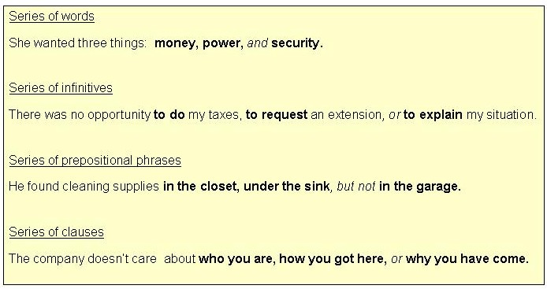
2. Use parallel structure with elements in lists or in a series.

Slide 9
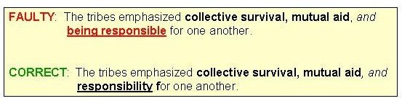
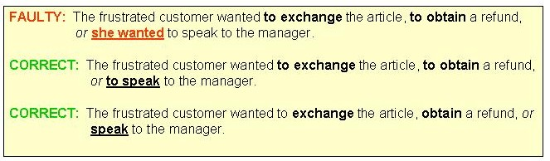
Faulty parallelism

Slide 10
Exercise
At the store my duties are to keep the shelves stocked, to work the registers, and assisting customers.
My brother enjoys three activities: checkers, welding, and he collects baseball cards.
We want a candidate who has a sense of commitment, a good record in public office, and who has experience in foreign affairs.
Reading mystery novels, exercising in the park, and crossword puzzles occupy a good deal of my retirement time.

Slide 11
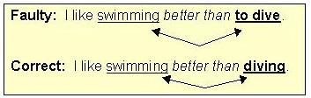
3. Use parallel structure with elements being compared.

Slide 12
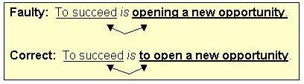
4. Use parallel structure with elements joined by a linking verb or a verb of being.
Seeing is believing.
To wait is to suffer.

Slide 13
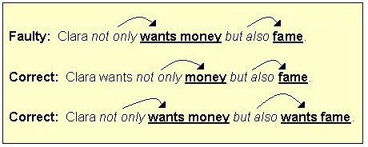
5. Use parallel structure with elements joined by a correlative conjunction.

Slide 14
Parallelism using correlatives
Nouns (She played both football and cricket in evening.)
Pronouns (They want to know whether you or I would go to attend the conference)
Adjectives (The teacher was neither flexible nor kind.)
Verbs (She did not only play the game but also won it.)
Adverbs (They work both hard and diligently.)
Prepositional phrases (I will meet you either at centre or in university.)
Sentences/Clauses (Not only did they fight but also defeated the enemies.)

Slide 15
Exercise: Fix parallelism errors
It is easier to tell the truth than lying to people you love.
For her birthday, Marsha received a cake, some clothes, and she got a new CD player.
Jim wanted to scare us by telling us a ghost story and he showed us a horror movie.
The witness described the suspect as tall, light-skinned, and with a beard.
Spending the day with you is better than if we were apart.
I want neither your sympathy nor do I want your pity.
This plan is creative but a risk.

Slide 16
Exercise: Fix parallelism errors
To apologize is showing courtesy towards another's feelings.
The restaurant has a large menu, delicious spaghetti, and the prices are low.
Hiking stresses your body but is enriching for your health.
My sister not only gives the dog treats but she also brushes him twice a day.

Slide 17
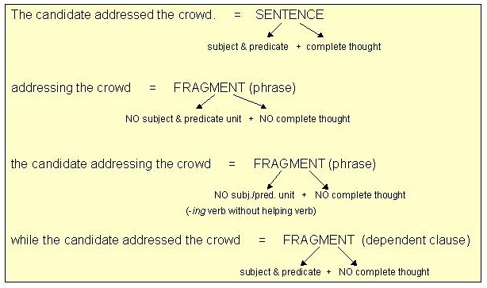
Avoiding Fragments
Dependent clauses or phrases are called fragments because they are missing one or more parts needed to make a sentence.
Therefore, they are only pieces or fragments of complete sentences.

Slide 18
Some Examples of Sentence Fragments
Because his car was in the shop.
After the rain stops.
When you finally take the test.
Since you asked me my name.
If you want to go with me.

Slide 19

Avoiding Comma Splices & Fused Sentences
Sometimes two independent clauses (simple sentences) can be joined to form another kind of sentence: the compound sentence.
Two major errors can occur when constructing compound sentences.
Error.1 Comma Splice
Writers make this error when they try to separate the two independent clauses in a compound sentence with a comma alone.

Slide 20



Repairing a comma splice: Three ways
Using an appropriate coordinating Conjunction
Using a semi colon
Changing the punctuation and adding an appropriate conjunctive adverb.

Slide 21

Error.2 Fused Sentence or Run-on sentence
Writers make this error by joining two independent clauses into a compound sentence without using any punctuation between them.
It was close to fall the trees were losing their leaves.
Same Rules of the Comma Splices can be used to repair the fused/run-on sentences.

Slide 22
Practice:
Fixing errors in Comma splices/run-ons/fragments
There was food left over, however, everyone had plenty to eat.
Some educated people believe in witchcraft, I am not one of them.
The zoo is a wonderful experience for everyone, you should go.
Mother got a letter from Aunt Esther, she is coming next week.
Eric is a brave boy, he doesn’t complain about his illness.
Hepatitis is serious, you should see your doctor.
The war lasted ten years many young men were killed.
My driver’s license was revoked I can’t drive to the game.

Slide 23
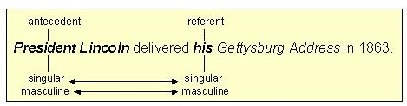
Pronoun-Antecedent Agreement
An antecedent is a word for which a pronoun stands. (ante = "before")
The pronoun must agree with its antecedent in number.
Rule: A singular pronoun must replace a singular noun; a plural pronoun must replace a plural noun.

Slide 24

Rules for Pronoun-antecedent Agreement
A phrase or clause between the subject and verb does not change the number of the antecedent.
Example:
The city of Karachi has its own glamour.

Slide 25


Indefinite pronouns as antecedents
Singular Indefinite Pronoun antecedents take singular pronoun referents.
Singular : Each, neither, either, one, no one, somebody, nobody, anybody, something, nothing, anything, everyone, everybody, everything
Plural indefinite pronoun antecedents require plural referents.
Plural: Several, Both, Few, many

Slide 26



Pronoun-antecedent Rules
Rule.3:
Compound subjects joined by and always take a plural referent.
Rule.4:
With compound subjects joined by or/nor, the referent pronoun agrees with the antecedent closer to the pronoun.

Slide 27
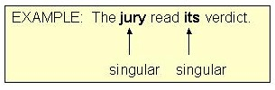



Pronoun-antecedent Agreement
Rule.5
Collective Nouns (group, jury, crowd, team, etc.) may be singular or plural, depending on meaning.
Rule.6
Titles of single entities. (books, organizations, countries, etc.) take a singular referent.

Slide 28



Pronoun-antecedent Agreement
Plural form subjects with a singular meaning take a singular referent. (news, measles, mumps, physics, etc)
The number of vs A number of before a subject:
The number of is singular.
A number of is plural.

Slide 29
Practice
1. During early rehearsals, an actor may forget (his or her, their ) lines.
2. The Washington team was opportunistic; (it, they ) took advantage of every break.
3. A person needs to see (his or her, their ) dentist twice a year.
4.The committee members put (its, their ) signatures on the document.
5. If any one of the sisters needs a ride, (she, they ) can call me.
6. When someone has been drinking, (he or she, they ) may drive poorly.
7. If the board of directors controls the company, (it, they ) may vote for a raise.
8. Neither the pilot nor the attendants gave (his or her, their ) opinion about the mishap.
9. Each of these companies had (its, their )books audited.
10. Some of the china has lost (its, their ) luster.

